Slide 1
Protect your business against cyber threats and information loss
Author name
Date

Slide 2
Threat landscape for small businesses
55K
$900K
71%
55K
60%
$900K
of cyberattacks target small businesses
Devices are compromised by ransomware every month
of small businesses close their doors after a cyberattack
is the average cyber attack remediation cost for small businesses

Slide 3
Why are attacks so successful?
It only takes hackers 4 minutes to get in your network, but 99+ days for businesses to discover they’ve been breached.
30%
63%
53%
of users open emails from attackers, 10% click on attachments or links
of passwords are weak, default, or stolen
of users accidentally share information

Slide 4
Where are the biggest security pains for small businesses?
Email
Subpar antivirus antispam doesn’t catch attacks
Users click on ransomware and phishing links
Accidentally send confidential data
Mobility
One extreme: Prohibit use because of security concerns
Or the other: Don’t provide any protection for data on devices
User credentials
Users have same passwords across all accounts, increasing risk if compromised
Attackers have sophisticated methods to easily steal credentials
Compliance
Standards don’t change based on company size
Requirements for GDPR and other regulations are rigorous and complex

Slide 5
Why don’t small businesses have the security they need?
Common misconceptions about small businesses contribute to the problem.
Security is too complex
While SMBs may not have in-house IT departments, that doesn’t mean they can’t implement comprehensive security. Technology and services can radically reduce complexity while also providing strong protection.
Security is too expensive
SMBs typically spend about 15% of their budget on security or $1,320/user annually. To increase protection, you don’t need to necessarily increase IT spend – just adjust how you are spending your dollars.
Security is not a business priority
Small businesses that deal with customer information – whether they are retail, financial, health care, or food services – have the same accountability to secure data as big enterprises, so they need enterprise- level protections.

Slide 6
Microsoft 365 Business
Business savvy way to reduce risk
security assessment link
Simple
One solution
Cloud platform simplifies deployment
Use this security assessment link well your business is protected from cybersecurity risks
Reduces costs
Eliminates costs for multiple third-party vendor solutions
Reduces maintenance and management costs
Aligns with business goals
Security built into your productivity platform
Don’t need to make trade-offs to justify security investment
Protect business against risk-related costs

Slide 7
Microsoft 365 Business security benefits
Safeguard your business against external threats and leaks
Protect against security threats
Protect business data against leaks
Control who has access to business information

Slide 8
Protect against security threats
Protect inboxes against spam and viruses
Block ransomware and phishing attacks
Keep Windows 10 devices safe from sophisticated malware
91%
15%
95%
of cyberattacks start with a phishing email
Of phishing attack victims fall victim a second time
of pushing attacks that led to a breach were followed by some form of software installation
3
1
1
1 Verizon 2017 Breach Investigations Reort (ref. P11 of Security Playbook)
2 Security Week Survey (ref P35 of Security Playbook)

Slide 9
Protect your business against data leaks
Restrict copying and saving of business information
Block sharing of sensitive information like credit card numbers
Prevent unauthorized users from opening or viewing sensitive documents
Encrypt data on mobile devices
Wipe data on lost or stolen devices
Back up email in secure archive
88%
48%
$158
of organization surveyed feel they are losing control over their data.
of survey responders say their outdated information security controls or architecture are a high area of vulnerability.
Cost incurred for each lost or stolen record containing sensitive and confidential information.
1
1
2

Slide 10
Control who has access to business information
Only let the good guys in
Know who is accessing your data
Keep credentials safe
Confirm identities with multi-factor authentication
Quarantine compromised devices
Prevent non-compliant devices from accessing your systems
81%
75%
Of all hacking-related breaches use compromised credentials.
of individuals use only 3 or 4 passwords across all of their accounts.
1
2
1 Verizon 2017 Breach Investigations Reort (ref. P11 of Security Playbook)
2 Security Week Survey (ref P35 of Security Playbook)

Slide 11
Our expertise + Microsoft 365 Business
We’re experts at…
Supporting point #1
Supporting point #2
Supporting point #3
We can help you…
Supporting point #1
Supporting point #2
Supporting point #3
We can manage your…
Supporting point #1
Supporting point #2
Supporting point #3

Slide 12
Next Steps
Download Partner Managed Services Deliverable
Take a guided tour of Microsoft 365 Business
Find more Microsoft 365 Business resources

Slide 13
Thank you

Slide 14
Appendix

Slide 15
Secure the Front Door
Identity-Driven Security
Go beyond passwords and protect against identity compromise, while automatically identifying potential breaches before they cause damage.
Risk-based Conditional Access and Multi-Factor Authentication
Advanced security reporting
Identify threats on-premises
Identify high-risk usage of cloud apps, user behavior, detect abnormal downloads, prevent threats

Slide 16
Secure Content
Protect content: creation, transit, consumption
Use cloud applications without putting company information at risk by adding protection, ranging from access privileges to data encryption.
Shadow IT Detection: Discovering Apps and Risk Scoring
Intelligent Classification and Tagging of content
Document encryption, tracking, revocation
Monitoring shared files and responding to potential leaks
Data segregation at a device/app level

Slide 17
Secure Devices
Workplace Issued or BYOD Devices
Manage company and BYOD devices to encrypt data and ensure compliance, automatically detect suspicious activities, and quickly block, quarantine, or wipe compromised devices.
Shadow IT Detection: Discovering Apps and Risk Scoring
Conditional Access
Device and App access level controls: PIN
Device and App encryption at rest
Save-As, Copy, Paste restrictions
Device and App level data wipe

Slide 18
Partner Microsoft 365 Assessment
How secure are you today?
Identify security objectives
Assess current security state
Provide customized recommendations and best practices
Create an actionable security roadmap
Notes:
This is a lot of reading – have assess, deploy and support as pictures not text. Simplify the text.
NOTE: we also have Partner Smart Office – on GitHub open source can help (Rackspace uses to aggregate for all customers) (in addition to Secure Score API). Stefan S. will review. (What he was talking about as a next step.
Foot in the door – if have office 365 and haven’t secured it, good for Secure Score.
Sold it – 20% monthly recurring revenue. What else can you do? Build service around Secure.
Ransomeware toolkit, secure score toolkit – Stefan can get us the complete list of toolkits.
Good slide is stair step – progression of things.
Left – floor. No cloud, server in office. Skeptical customer not ready for M365 but feeling pain with email. Sell Exchange Online $4/month
- Exchange Online Protection (spam and virus protection, huge upgrade from what they have now. Hands-off, proper functioning, allway uptodate antispam and antiv platform)
Next – Office 365 -- $15/month
Exchange Online Protection
Secure Score – advise them and get in proper configruation
Last – M365 -- $20/month
-Office ATP
Phishing protection
Ransomware
Mobile device security
Identify AAD
Now established, here’s what to think of next – how to get margin past 20%.
Assessments
Secure score-based monitoring services – we watch the watchers, etc.

Slide 19
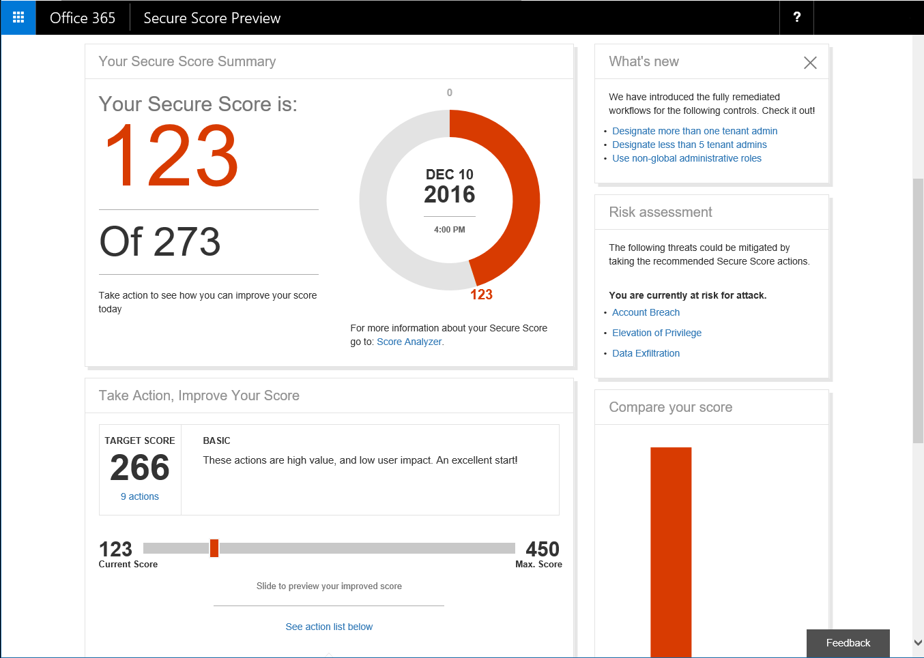
Partner security monitoring service
Get daily insight into your security risk profile
Establish security baseline
Continuous monitoring and reporting to reduce risk
Integrate data into compliance or cybersecurity apps to improve overall protections

Slide 20
Partner managed identity service
Ensure that only your employees are accessing your systems.
Keep bad guys out | Threat monitoring and prevention to block viruses, malware, ransomware, phishing, and spam attacks
Only let the good guys in | Identity & access management for limiting access to business apps and servers
Show how you stopped them | Power BI automated dashboards to show incidents logged and threats prevented.

Slide 21
Partner secure content service
Prevent customer and business data from falling into the wrong hands.
Enforce who can open documents | Document encryption monitoring and remediation
Don’t accidentally share confidential information | Monitoring and enforcement for access to shared files in email and team sites
Encrypt corporate data on mobile devices | Separation of personal information and business information on phones and tablets
Prove that you’ve kept information safe | Archiving and compliance reporting for email and/or backup and disaster recovery

Slide 22
Partner managed identity service
Ensure your employees can safely work on their smart phones and tablets.
Secure every employee device | Endpoint security monitoring and remediation for laptops, PCs, tablets, and phones
Create ready-to-use secure devices | Device as a service offering that includes hardware support
Don’t let corrupt devices talk to your systems | Corrupt device quarantining and download prevention
Lock down lost or stolen devices | Remote wipe

